Slide 1

Unit 10
If you go to the party,
you’ll have a great time!

Slide 2


Slide 3

I.根据句意，从方框中选择恰当的单词填空。
video, meet, chocolate, order, organize
meeting
1. What did Mrs. White talk about at the _________?
2. I bought these CDs in a(n) _______ shop on River Road.
3. When is a good time _________ food from that restaurant?
4. The club __________ different kinds of activities every term.
5. Although _________ is delicious, I don’t think you should eat it too often.
video
to order
organizes
chocolate

Slide 4
Ⅱ. 根据汉语意思完成英语句子。
1. 许多孩子喜欢吃炸薯条。
Many children like eating ________ ________.
2. 我妈妈叫我每天喝牛奶。
My mom ________ ________ ________ ________ milk every day.
3. 请把英语书给我。
Please ________ ________ ________ ________ ________.
potato chips
asks me to
drink
give me the English
book

Slide 5
4. 为了保持健康，我们应该先洗手。
To keep healthy, _________ _________ _________ our hands first.
5. 如果你刻苦练习的话，你的钢琴会弹得很好。
_________ you _________ hard, _________ _________ the piano very well.
we should
wash
If practice you'll
play

Slide 6
Ⅲ. 根据对话内容选择恰当的选项补全对话。
A: Hello, Tony! You look worried. What’s wrong?
B: I can’t find my bike.
A: You lost your bike? (1)________
B: I rode my bike to the library yesterday afternoon. I put my bike on the street. When I came out of the library, it was gone (不见了).
A. How did it happen? B. I think that’s a great idea! C. Then how did you go home? D. If I do, my parents may be angry with me. E. But I don’t have enough money to buy a new one.
A

Slide 7
A. How did it happen? B. I think that’s a great idea! C. Then how did you go home? D. If I do, my parents may be angry with me. E. But I don’t have enough money to buy a new one.
A: (2)________
B: By bus.
A: I think you need to buy a new bike.
B: (3)________
A: You can borrow (借) some from your parents.
B: (4)________
A: Why not have a good talk with them and say you’re sorry?
B: (5)________ I’ll have a try this evening.
C
E
D
B

Slide 8


Slide 9

Ⅰ. 根据句意及括号内所给词的提示填空。
1. I __________(not go) fishing if it __________(not be) fine tomorrow.
2. Please tell me if you __________(need) help.
3. If it __________(rain) tomorrow, we __________(take) a taxi to the museum.
4. If he ___________(not call) me, I ___________(not leave) here.
5. What will you do if you __________(feel) upset?
won’t go
isn’t
need
rains
will take
doesn’t call
won’t leave
feel

Slide 10
6. In 20 years, I think I __________(be) a newspaper reporter.
7. I think we __________(visit) the new factory next Friday.
8. Should students __________(help) their parents with housework?
will be
will visit
help

Slide 11
Ⅱ. 根据短文内容及提示补全短文。
I'm thinking about getting a job during this summer vacation.
(1)___________________________________(如果我找到工作的话，我会赚一些钱). If so, I will have money to buy some things. I can buy some new clothes, some books or some music CDs. Or I can use the money to help some poor children.
(2)___________________________________________(如果我找不到工作的话，我会去看望我爷爷奶奶). They live in a beautiful house near the beach.
If I get a job, I will make some money
If I don’t get a job, I will visit my grandparents

Slide 12
If I live with them, I will be very happy
(3)_____________________________________(如果我和他们一起生活的话，我会很开心)! (4)_______________________________________(我不必每天七点起床). I will stay up late and I will eat lots of delicious food. What's more, I will play on the beach. You know, (5)__________________________________ (在那里玩总是很有趣).
I won’t have to get up at 7 o’clock every day
playing there is always fun/interesting

Slide 13


Slide 14
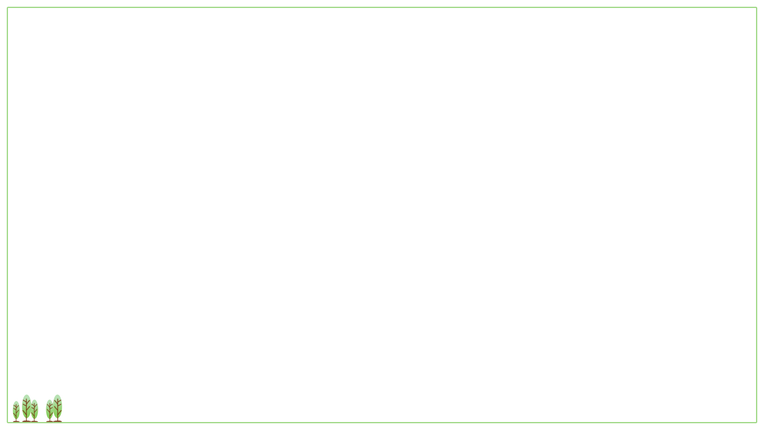
Ⅰ. 根据语境，从方框中选择恰当的单词填空。
1. Music is a very important part of __________ life.
2. Paul often breaks his promise. No one __________ him.
3. Mike and Greg will go to the library. Who __________ is going?
4. The __________ temperature of the human body is about 36.7℃.
wallet, anger, care, he, step, trust, certain, else, teenager, normal
teenagers’
trusts
else
normal

Slide 15
wallet, anger, care, he, step, trust, certain, else, teenager, normal
5. Bruce was so __________ that he left his schoolbag on the bus.
6. My grandmother walks about 5,000 __________ every day to keep healthy.
7. My cousin is only 6 years old, but he can look after __________ very well.
8. —I’m afraid the shoes are too small. Can I try bigger ones?
—__________. Here you are.
careless
steps
himself
Certainly

Slide 16
wallet, anger, care, he, step, trust, certain, else, teenager, normal
9. —Did you get money from the bank?
—No, I didn’t need to. I had enough in my __________.
10. One of the boys kept talking in class. That made our teacher very __________.
wallet
angry

Slide 17
Ⅱ. 根据句意及提示，写出所缺短语。
1. Mom ________ ________ __________ ______ _________(把西瓜切成两半) just now.
2. Mr. Steen _______ ________ ________ ________ __________ (有丰富的经验) in teaching math.
3. Don’t tell it to others. Please _________ _________ _________ _________(保守秘密).
4. If I make enough money, I ________ ________ ________ _______ _______(周游世界).
cut the watermelon in
half
has a lot of
experience
keep it
to yourself
will travel around
the world

Slide 18
solve
5. Here are some simple ways to _________ _________ _________(解决这些问题).
6. If you are not careful enough, you ________ _________ ________(将会犯错) in your work.
these problems
will
make mistakes

Slide 19
Ⅲ. 根据汉语及提示，翻译下列句子。
1. Mr. Hunt想逃离忙碌的生活。(run away from)
2. 我们可以就运动方面给你提出建议。 (advise)
3. 我们完成了这项工作的一半。 (halfway)
4. 如果你不马上走的话，你会迟到的。 (unless)
5. 最好不要吃太多的甜食。 (It is best not to ...)
Mr. Hunt wants to run away from his busy life.
We can advise you about/on sports.
We’re halfway to finishing the job.
Unless you go at once, you will be late /
You will be late unless you go at once.
It is best not to eat too much sweet food.

Slide 20


Slide 21

根据短文内容从方框中选择恰当的单词填空。
certain, anger, advise, teenager, mistake, solve, normal, understand
“Will you be unhappy when you have problems?” The answer is (1)__________ “Yes!”
It is (2)__________ that everyone has problems. When you have problems and don't know how to be happy, you should read the book “How to (3)__________ teenagers’ problems”. The book is useful. In the book, you can get a lot of (4)__________ from the writer.
certainly
normal
solve
advice

Slide 22
certain, anger, advise, teenager, mistake, solve, normal, understand
The book discusses many subjects, such as problems with parents, friends or teachers. The book says we should stop being (5)__________ with others and learn to be a(n) (6)_______________ person. The book also teaches us some skills. For example, to make us remember things well, we can change (改变) what we have learned into pictures.
angry
understanding

Slide 23
certain, anger, advise, teenager, mistake, solve, normal, understand
teenagers
Many (7)__________ think that happiness comes from a good exam result or other success. But you can still be happy though there are no such “good” things. Success comes from a good attitude (态度). If you can learn from problems and (8)__________, you will be successful in the future.
mistakes

